Slide 1
Superscalar and Vector Pipeline
Superscalar and vector pipelines are both techniques that can improve the performance of a processor by executing multiple instructions in parallel.
Superscalar Pipeline Design
A superscalar processor can execute multiple instructions per clock cycle by using multiple execution units. It employs instruction-level parallelism (ILP) to boost performance.

Slide 2
Instruction Level Parallelism
Instruction Level Parallelism (ILP) is used to refer to the architecture in which multiple operations can be performed parallelly in a particular process, with its own set of resources – address space, registers, identifiers, state, and program counters.
It refers to the compiler design techniques and processors designed to execute operations, like memory load and store, integer addition, and float multiplication, in parallel to improve the performance of the processors.
Instruction-level parallelism can also appear explicitly in the instruction set. VLIW (Very Long Instruction Word) machines have instructions that can issue multiple operations in parallel.
The Intel IA64 is a well-known example of such an architecture.

Slide 3
Disadvantages of VLIW
Compiler Complexity: The compiler must be highly sophisticated to manage dependencies and avoid stall-inducing conflicts.
Code Size: The use of very long words can lead to larger binary sizes (code bloat).
Performance Variability: If the compiler cannot find enough parallel instructions, many functional units may sit idle, reducing efficiency.
Instruction Level Parallelism is achieved when multiple operations are performed in a single cycle, which is done by either executing them simultaneously or by utilizing gaps between two successive operations that are created due to the latencies.

Slide 4
Key Features of Superscalar Architecture:
Multiple Pipelines: Instead of a single pipeline, multiple functional units execute instructions simultaneously.
Dynamic Instruction Scheduling: Hardware dynamically schedules instructions to maximize parallel execution.
Out-of-Order Execution (OoO): Instructions can be executed in an order different from their appearance in the program to avoid stalls.
Register Renaming: Eliminates false dependencies (WAR and WAW hazards).
*WAR (Write After Read) and WAW (Write After Write) hazards are types of data dependencies that can occur in a pipelined processor when instructions try to access the same register, but in an order that could lead to incorrect results.

Slide 5
Superscalar Pipeline Stages:
1. Instruction Fetch: Multiple instructions are fetched from memory.
2. Instruction Decode: Decodes instructions and identifies parallel execution opportunities.
3. Instruction Dispatch: Sends instructions to different functional units.
4. Execution: Multiple execution units process instructions in parallel.
5. Write-back: Stores results back to registers or memory.

Slide 6
A typical superscalar processor (e.g., Intel Core i7) may have:
• Integer ALUs
• Floating-Point Units (FPUs)
• Load/Store Units
• Branch Units
Each of these can execute instructions in parallel, increasing overall throughput.

Slide 7
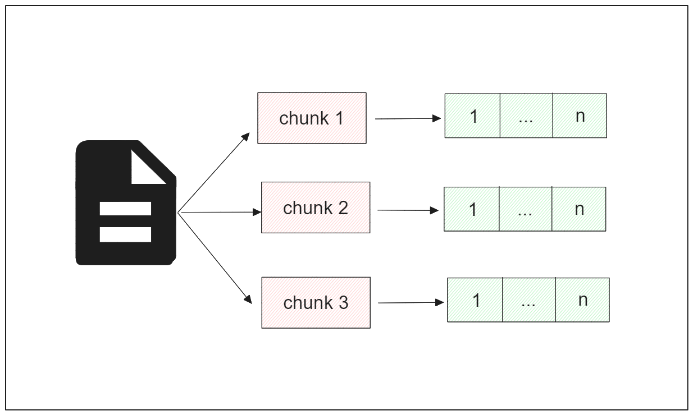
Vector Pipeline Design
A vector processor processes data in large chunks called vectors, rather than individual scalar values. This design is optimized for data-parallel workloads such as multimedia processing, scientific computing, and AI workloads.

Slide 8
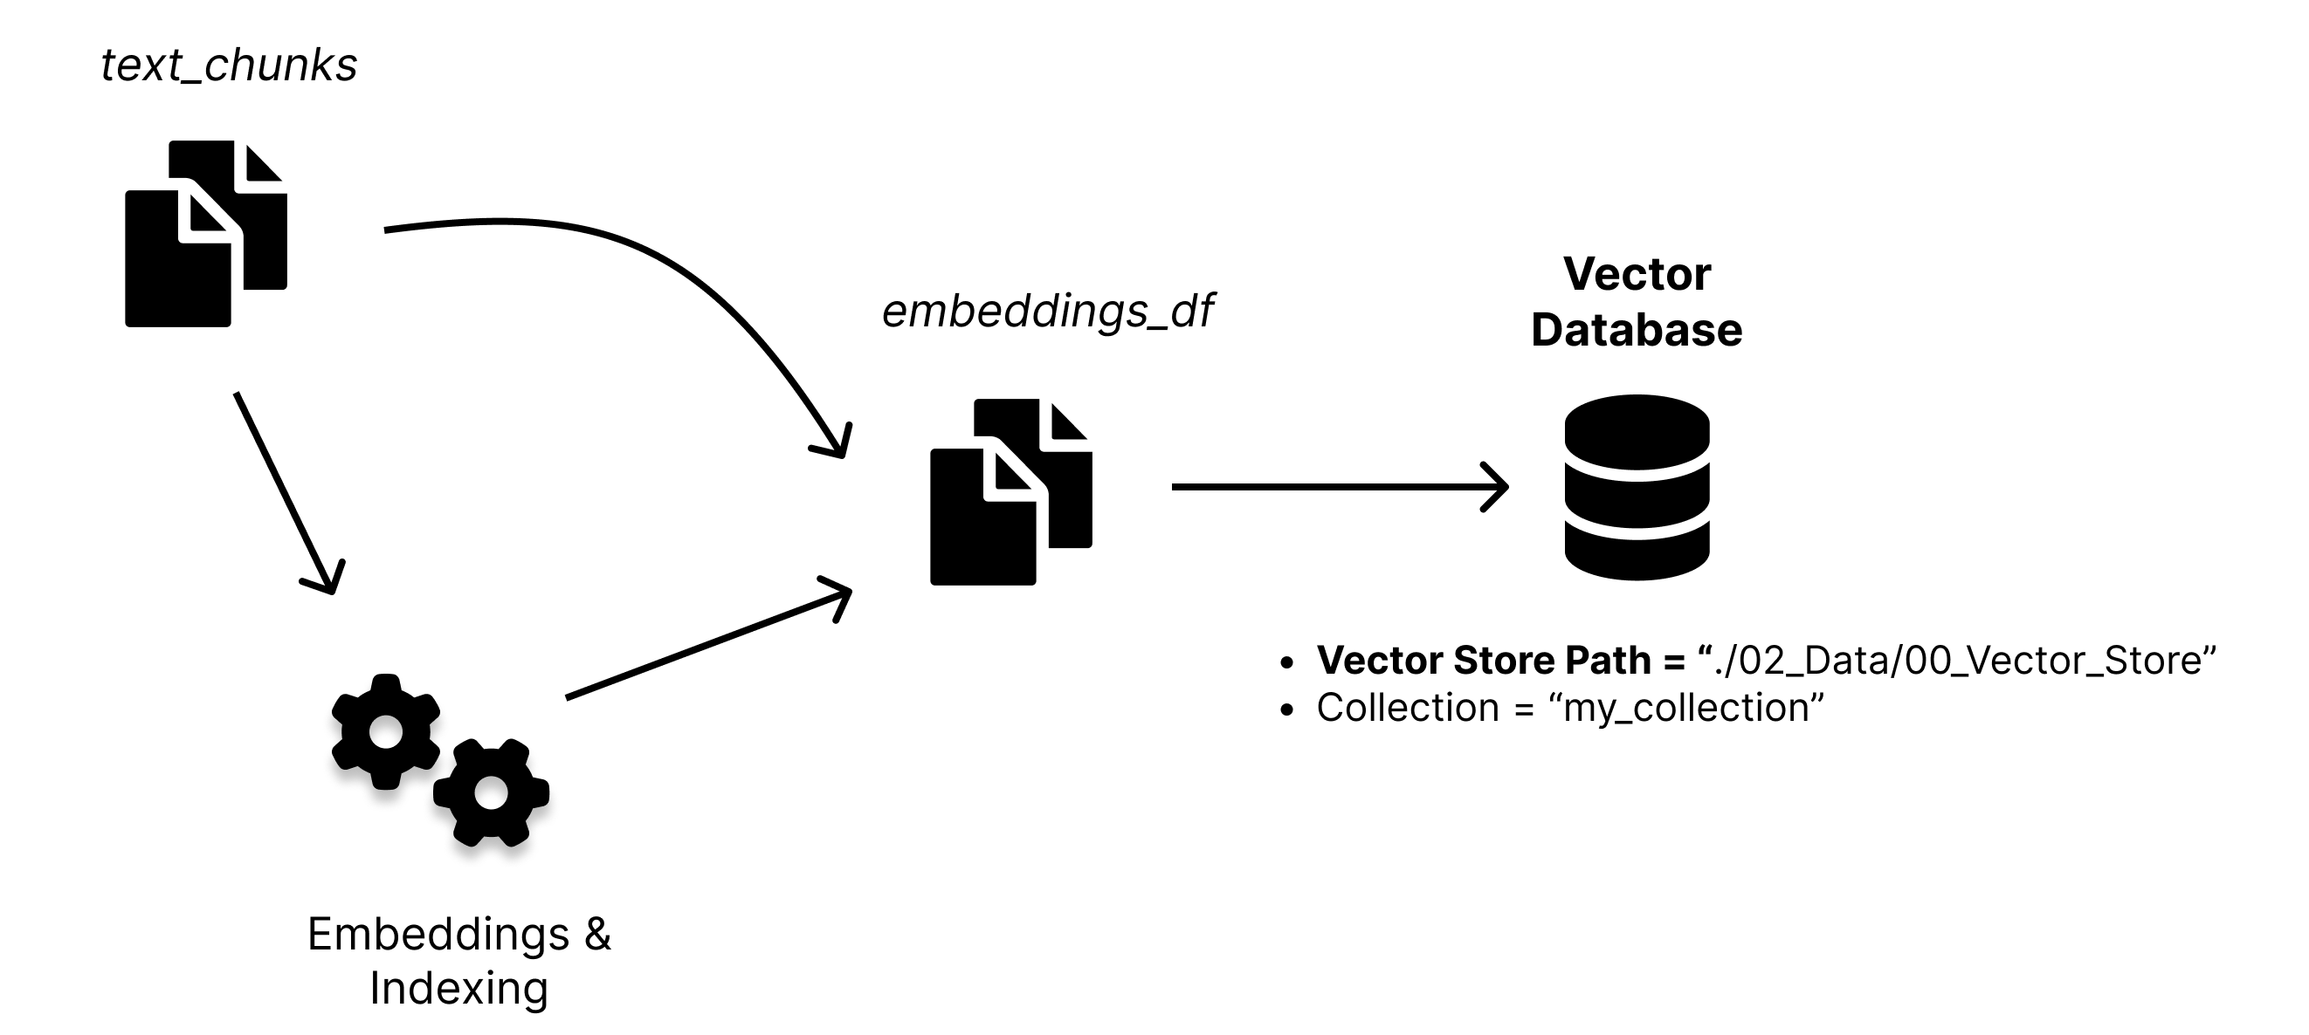
Chunking: Large documents are split into smaller, manageable pieces (chunks) to fit within model token limits and improve retrieval precision.
Embedding Generation: turn text chunks into numerical vectors (lists of numbers) that capture semantic meaning.
Indexing: The generated vectors are stored in a vector database, allowing for efficient similarity searches when a user asks a question.

Slide 9
Key Features of Vector Architecture:
Single Instruction, Multiple Data (SIMD): One instruction operates on multiple data elements simultaneously.
Vector Registers: Stores arrays of data for parallel processing.
Efficient Memory Access: Uses stride-based memory access to efficiently load/store vector data.
Pipelined Functional Units: Supports deep pipelining for vector computations.
*Stride-based memory is a way of organizing data in memory, where the stride indicates the number of elements to skip to access the next element. e.g., accessing elements in an array)

Slide 10
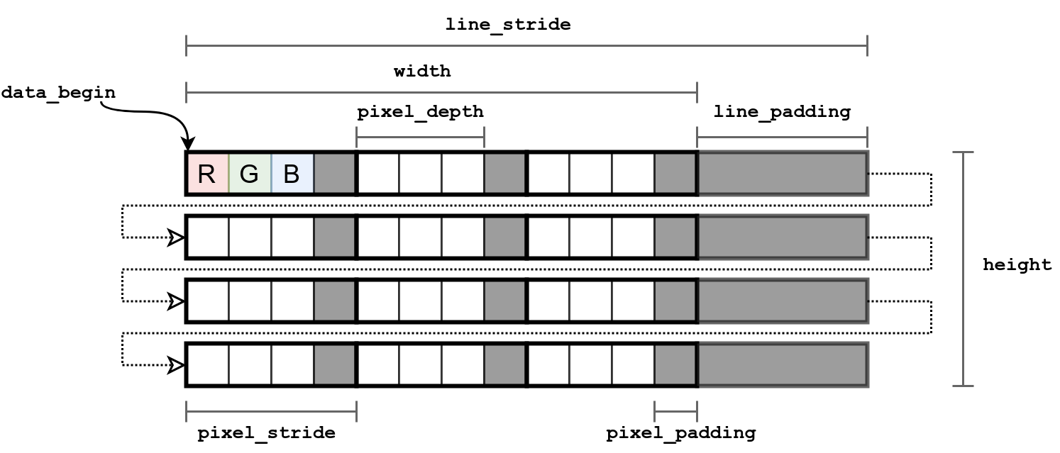

Slide 11
pixel Depth: The number of bits or bytes used to store the color information of a single pixel (e.g., 3 bytes for RGB).
Pixel Stride: The total number of bytes occupied by one pixel in memory, which includes the pixel depth and any potential pixel padding.
Pixel Padding: Extra bytes added to a pixel's memory block to align data for performance optimization.
Line Stride: The total number of bytes occupied by one complete row (line) of pixels in memory. This includes the data for all pixels in the row plus any line padding.
Line Padding: Extra bytes added to the end of a line of pixels to ensure the start of the next line is aligned correctly in memory.
Width: The actual number of pixels horizontally in the image.
Height: The actual number of pixels vertically in the image.
data\_begin: The memory address where the image data starts

Slide 12
Vector Pipeline Stages:
Vector Load: Loads a vector of data from memory into vector registers.
Vector Decode: Decodes a single vector instruction.
Vector Execution: Multiple elements are processed in parallel using vector ALUs.
Vector Store: Stores computed vector results back into memory.

Slide 13
Example:
Intel AVX (Advanced Vector Extensions) and ARM NEON are modern vector processing extensions.
GPUs use vector processing to handle thousands of parallel computations.

Slide 14
Feature | Superscalar Pipeline | Vector Pipeline
Parallelism Type | Instruction-Level Parallelism (ILP) | Data-Level Parallelism (DLP)
Execution Model | Multiple scalar instructions execute in parallel | Single instruction operates on multiple data elements
Registers | General-purpose registers | Vector registers
Use Case | General-purpose computing, out-of-order execution | Scientific computing, AI, multimedia processing
Examples | Intel Core, AMD Ryzen | Intel AVX, ARM NEON, GPUs

